Slide 1
Data Extract Tool

Slide 2
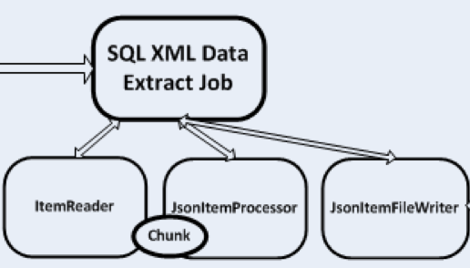

What is it?
Moves data in bulk using pluggable “reader” and “writer” classes
Reader: connect to any source including SQL
Processor: convert from JDBC results or XML results to JSON
Writer: export to the file-system or MarkLogic directly
Extract
Reader
Processor
Writer
Notes:
Continual innovation is critical to maintain and grow market share and successfully support your business needs. A MarkLogic COE assists your organization in evaluating and applying technology resources in strategic alignment with your business priorities.
Assessing new projects for technology fit ensures that your organization leverages the right technology solution, reducing project timelines and increasing success rates. And strategically applying deep expertise in MarkLogic allows your organization to successfully implement higher complexity projects with higher quality in a shorter amount of time.

Slide 3
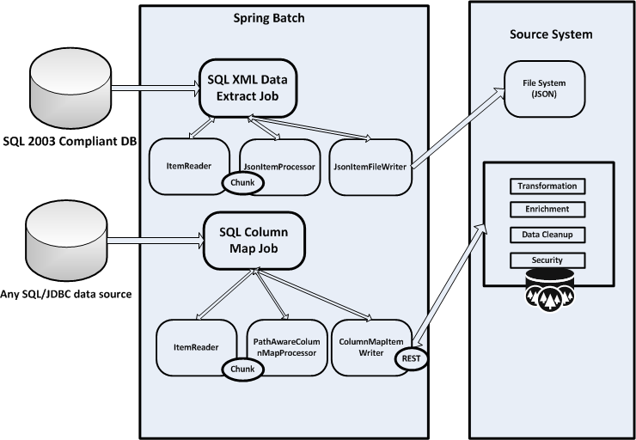
XML and SQL Extract to JSON
Notes:
COE Features
A MarkLogic COE combines deep insight of MarkLogic technology with knowledge of your specific business. We’ll work with
you to develop the tools, processes, methodologies, services, and the team that will comprise your MarkLogic COE and provide expertise at leveraging MarkLogic technology across your organization.
Tools and Process Capabilities
The COE maintains the tools and processes needed to quickly stand-up and execute new applications built on MarkLogic. Providing a standard development environment and maintaining a library of re-useable components accelerates delivery and reduces new project risk.
Engineering Services
The COE offers services in all aspects of engineering including feasibility analysis, architecture planning, code review, code development, data migration planning and design, system health checks, and overall technical support. COE members provide expertise in MarkLogic Server, XML, XQuery, XSLT, Data Science, Big Data strategies and other related technologies.
Organizational Support
At the Organizational level, the COE communicates, facilitates, and educates stakeholders on the usage of the MarkLogic technology platform. Training and education are provided through informal Brown Bags and Seminars as well as through onsite MarkLogic courses or external MarkLogic training and conferences. The COE assists with resource management by maintaining an inventory of trained and certified staff members. The COE also serves as the central point for MarkLogic within the organization, fostering internal communication and discussion related to MarkLogic technology.
Operational Assistance
The COE’s deep technical capabilities serve as Tier 3 support for all applications built on MarkLogic, allowing the organization to respond rapidly to operational issues. The COE also manages the client- vendor relationship with MarkLogic Corporation, interfacing with MarkLogic Product Support and Product Management, to monitor release schedules and understand how to best leverage new product features and the best rollout strategy for your organization.

Slide 4
Simple Usage
Pre-requisite: download the .zip and install Java
Put SQL/XML or plain SQL into a properties file
Run the job pointing to the DB2 instance, SQL file and output directory
Alternatively, use pure SQL in the properties file and use the “column map” configuration
Supports one level of nesting: for example Person/Address
Select XML or Column Map by using appropriate job configuration class

Slide 5
Demo
Extract and load Person/Address data using SQL/XML configuration
Extract and load Person/Address data using column map configuration

